Slide 1

Potential for Privatization of Regional Airports
Nils Küsgen / Hansjochen Ehmer, Bad Honnef
GAB Workshop Airport Benchmarking
Berlin, 20.6. 2012

Slide 2
Content
Definitons
Placement of the topic in the context of regional airports
Non Aviation opportunities
Potential of cooperation
Economic factor airport
Privatization pro/contra
Summary

Slide 3
What is defined a regional airport?
- There is no consistent definition.
Each organization has its own definition (ACI, ADV, DFS ...)
Classification | Description | Passengers per year
Category A | Large Community airports | > 10 million
Category B | National Airports | 5-10 million
Category C | Large regional airports | 1-5 million
Category D | Small regional airports | < 1 million

Slide 4

Definition of Potential
A „potential“ describes the possibility, or likelihood, of successful development (in a particular way).
(Kernerman English Multilingual Dictionary, 2006-2010)
How can potential be developed?
Notes:
The second important term which needed to be defined is „potential“.
This word is used such often, that I thought it could be of interest,

Slide 5
Placement of the topic in the context of regional airports

Slide 6
Current situation
Most regional airports loss making
Most regional airports in the public hand
Lots of regional airports in remote areas

Slide 7
Reasons for losses
See previous presentations of Tolga Ülkü & Branco Bubalo! Most airports below 1 Mio pax produce losses
Not enough traffic
Dependency of a single carrier
– in most cases Ryanair
– in some cases a regional airline
Passenger – employee – relation very bad
  Caused by regulation
  Caused by ownership

Slide 8
Reasons for losses

Slide 9
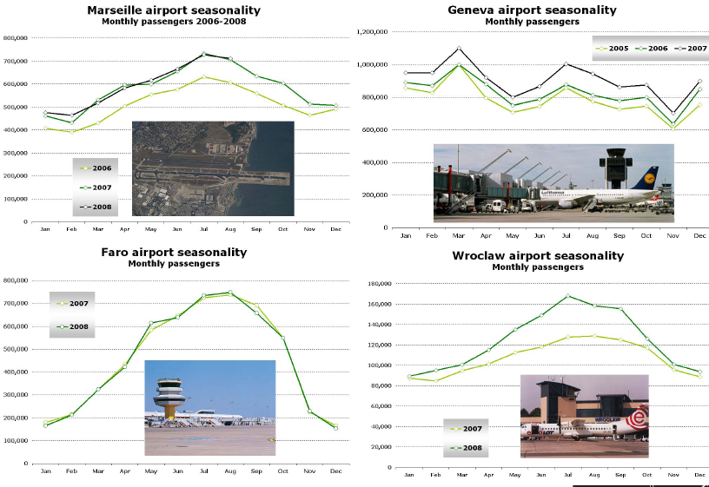
Examples on seasonality
9
Notes:
9

Slide 10
Not enough traffic: European comparison of airport density – airports per km²
Overall | Airports per 10.000km²
EU 27 | 0,9348
Candidates | 0,5883
EU 31 | 0,8728
other | 1,3129
Total | 0,9050
Well-developed countries like Germany, Spain, France are below overall EU average
Different circumstances in different countries
Notes:
excluded: Malta, Luxembourg and Cyprus due to too high Airport Area Density
Orange = candidate states
Black = other European Countries
Grey = Germany
EU27 = EU of today
EU31 = EU of today + candidate states
10

Slide 11
European comparison of airport density – airports per inhabitants
Overall | Airports per 1 Mio Inh.
EU 27 | 0,8280
Candidates | 0,7176
EU 31 | 0,8129
other | 4,4178
Total | 0,8898
Significant changes compared to area density
Germany is ranked
29 out of 33 only
Scandinavian countries score highest
Unequal distribution of capacity
Lots of these airports have overcapacity
Notes:
Excluded: Norway & Iceland due to too high Airport Population Density
Orange = candidate states
Black = other European Countries
Grey = Germany
EU27 = EU of today
EU31 = EU of today + candidate states
11

Slide 12
Dependancy of a single carrier

Slide 13
Decisions to Create Potential
Increase passenger figures and cargo volume.
Explore ideas for new business fields
- airport business parks – Zweibrücken
- non aviation business
- MRO services – Shannon
Seek cooperation with bigger airports
    HAM / LBK
    DUS / MGL
    MUC / AUG
Calculate the time required to put the plan into action.

Slide 14
Non-Aviation

Slide 15
Non-Aviation Sector
Airports are nowadays dependent on the non-aeronautical income.
12.1 billion €uro (2009)
European airports in 2009
Cost pressure on the airline side let aeronautical income decrease.
Investments in infrastructure → generated through the non-aviation sector.

Slide 16
Business Fields in non-aviation
Non-Aeronautical Revenues | 100%
Retail Concessions | 28%
Food & Beverage | 5%
Car Parking | 14%
Rental Car Concessions | 3%
Property Income / Rent | 18%
Advertising | 2%
Others | 30%
Especially regional airports (with high proportion of LCC traffic) need to make use of these sectors to increase their profitability. But in respect to the fact that LCC passengers are price sensitive.
Notes:
Lidl statt D&G

Slide 17
Cooperations with other airports

Slide 18
Cooperation strategies
HAM / LBK 2 independent airports cooperate “mutual” help
DUS / MGL + MUC / AUG
  take over of the smaller one
  Reliever function, esp. for business traffic
  Stop of scheduled services!!
FRA / HHN failed
  Reliever function, esp. take over night cargo traffic
Is the take over of a public regional airport by another public airport privatization?

Slide 19
Privatization

Slide 20
Ways of Privatization
Fully privatized
  Parchim
  London City
Partially privatized (state owned / private owned)
  Frankfurt
  Weeze ?
Fully state owned
  Hahn

Slide 21
Interest Groups
The topic must further be broken down to two
interest groups:
Seller Buyer
create jobs
increase economic growth
services for the public
in need of money
make profit
ensuring location
creating business oportunities
Notes:
These 2 interest groups have different objectives when talking about an airport.
The seller (respectively the local government) wants to create jobs, increase economic growth and offer convinient sercices to the public.
Whether the investor wants to make profit, primarily.

Slide 22
Why Selling a Regional Airport?
Regional airports are often loss businesses.
Governments need to save money.
Airports are far to important for a region, so that they cant be shut down.
Since they are there … - what can be done else?
A well running (regional) airport is a good opportunity to create economic growth in the region around it.
Notes:
Governments are searching for investors, to to simply increase the efficiency of those airports and to limit the losses.

Slide 23
Economic Factor
(Regional) Airport
For every million passenger....
-
2,950 jobs nationally.
-
2,000 jobs regionally.
-
1,425 jobs sub-regionally.
But you first need to get a million passengers! ☺
... are created.
(ACI research 2004)
Notes:
It is of no doubt, that airports do play a major economic role in their region. As you can see here, ....
They are often called job-motors.

Slide 24
Importance for the Region
Politicians love the term „job-motor“.
They do almost everything to have such a motor in their election distrcit, because they are:
Paying subsidies to airlines
Paying infrastructure renewal/creation
Paying losses of the airports operational business with taxes (if it is locally owned)
Politicians should have more in mind
the airport as infrastructure
Notes:
Die geister die ich rief

Slide 25
Job motor or infrastructure?
An LCC comes with an aircraft with about 180 seats
High fix cost with very low usage
Special needs for scheduled services
Is the airport better off without scheduled services?
Altenburg case: with Ryanair 70 employees; without only 15!
Augsburg case: without regional services profitable
A small regional airport can be run with 7 employees

Slide 26
Pro
+
Positive effects of privatization:
Delivers an increase in efficiency.
Investment in new buildings/infrastructure (e.g. fonds, banks) according demand.
Private interest instead of public prestige.
If Public Private Partnership
→ Interests of the government will additionally be safeguarded.

Slide 27
Contra
-
Negative effects of privatization:
Decrease in security (rumor or proof?).
Decrease in service (if no competition).
No investment in infrastructure (squeeze out the existing).
Lay off of workers.
Losses of airport must be caught by government (to prevent shut down).

Slide 28
Summary
The big airports overloaded but demand continues to rise
→smaller airports the important tool to accommodate this.
Demand for regional airports was growing but vulnerable.
Regional airports needed in Germany to face future challenges.
Easy travel to the city at most regional airports.
Regional airports without links to cities have bus-rail and city center shuttles.
Due to budgetary constraints the support is often not at it’s needed level.
Notes:
(Bremen airport: http://www.gtai.com/homepage/info-service/publications/our-publications/germany-investment-magazine/vol-2010/vol-022010/german-business-2/)

Slide 29
Summary
That means…
→ Privatization of regional airports (especially in Germany) could be a tool for meeting the demand of the future!
Thank you for your attention.
Notes:
Therefore,

Slide 30
Thank you for your attention.

Slide 31
Failed capacity increase
Decrease in regional GDP by
2.5%
-
3%

Slide 32

Ethiad at Hahn
Since first week of July, regular traffic between Hahn and Abu Dhabi
Ethiad put a brandnew Boeing 777-200F into operation
This plane has the lowest operatin costs for a freighter in the world
It can carry up to 102 tonns
49% increase in freight at Hahn airport (between Janurary and May, compared to 2010)
Notes:
118.000 tonns freight

Slide 33
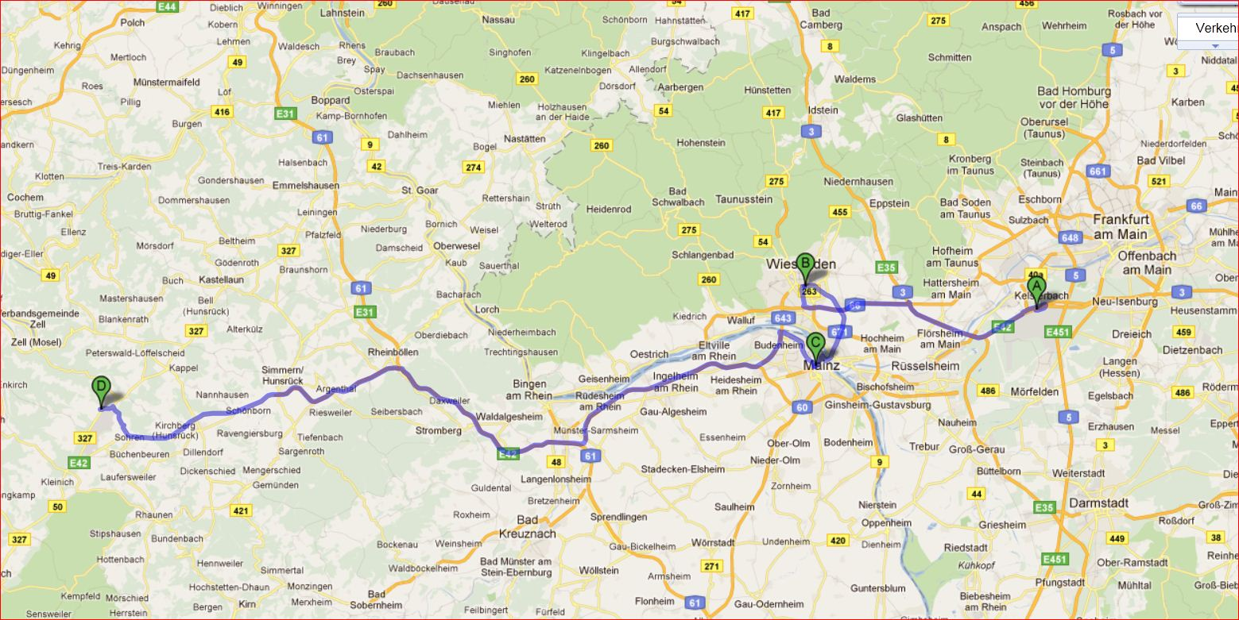
Rhein-Main Area

Slide 34
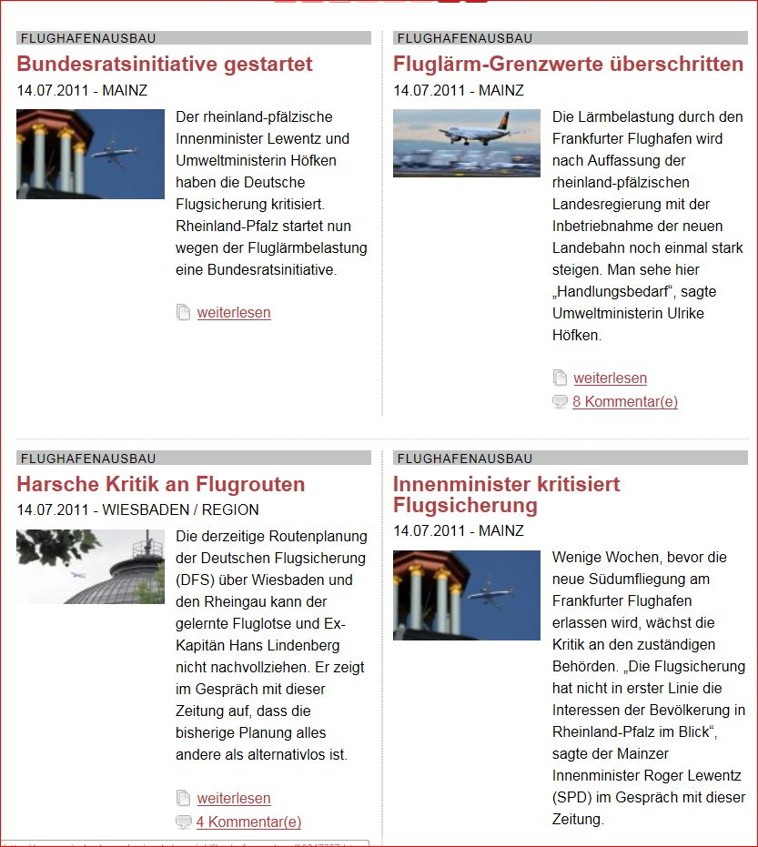

Slide 35
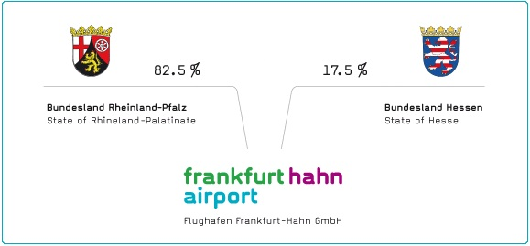
Shareholders
Shareholder structure | Fraport
State of Hesse | 31.49 %
Stadtwerke Frankfurt am Main Holding GmbH | 20.11 %
Artio Global Investors Inc. | 9.96 %
Deutsche Lufthansa AG | 9.92 %
Unknown | 28.52 %

Slide 36

Influencing factors
Airline
interest
Environmental
National interest
Economic interests
(invetsors)
Regional interest

Slide 37
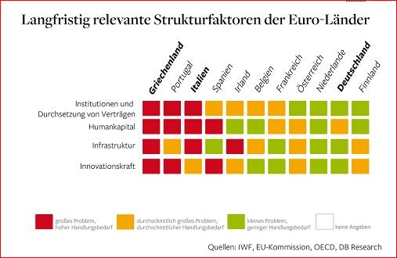

Slide 38
Capacity gap: at the one side lack of capacity, overcapacity at smaller airports.
Cooperation between bigger and smaller airports
  example FRA - HHN
  example HAM – LBK
Airport density too high

